Slide 1
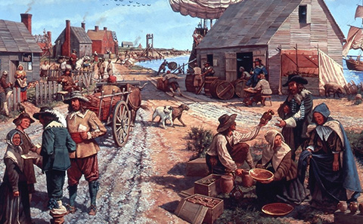
The Thirteen British Colonies
Part 6-
Mercantilism and Salutary Neglect

Slide 2
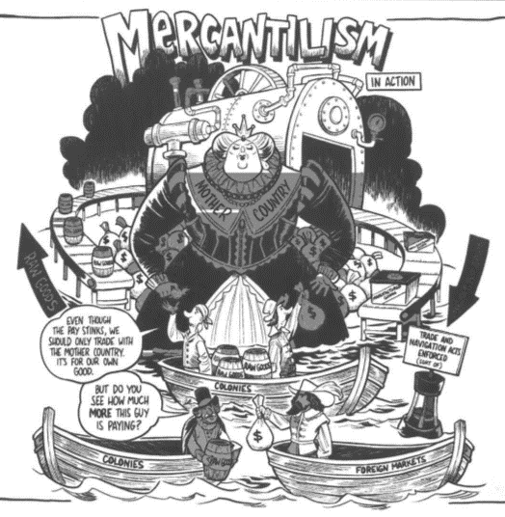
Look at the political cartoon entitled Mercantilism. With your partner, explain what the different parts of the cartoon mean and the overall meaning of the cartoon.

Slide 3
The economic system for the British empire during the 17th and 18th centuries was called mercantilism.

Slide 4
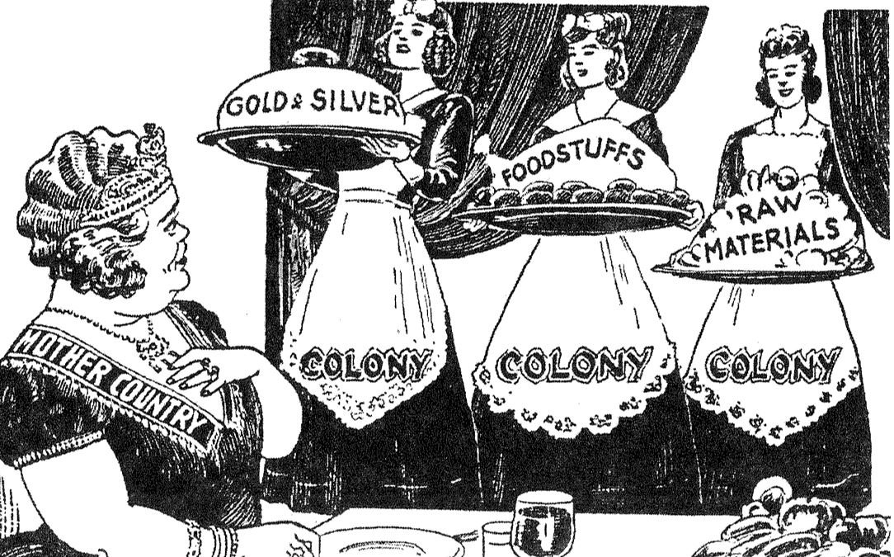
This idea was that the sole economic purpose of the colonies was to enrich the economy of England.

Slide 5
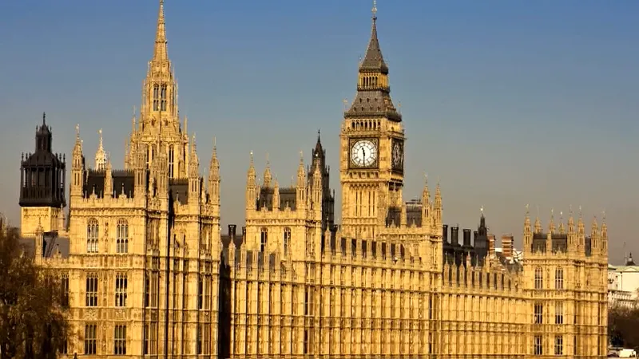
When it came to trade, the British Parliament told Americans what they could and could not do.

Slide 6
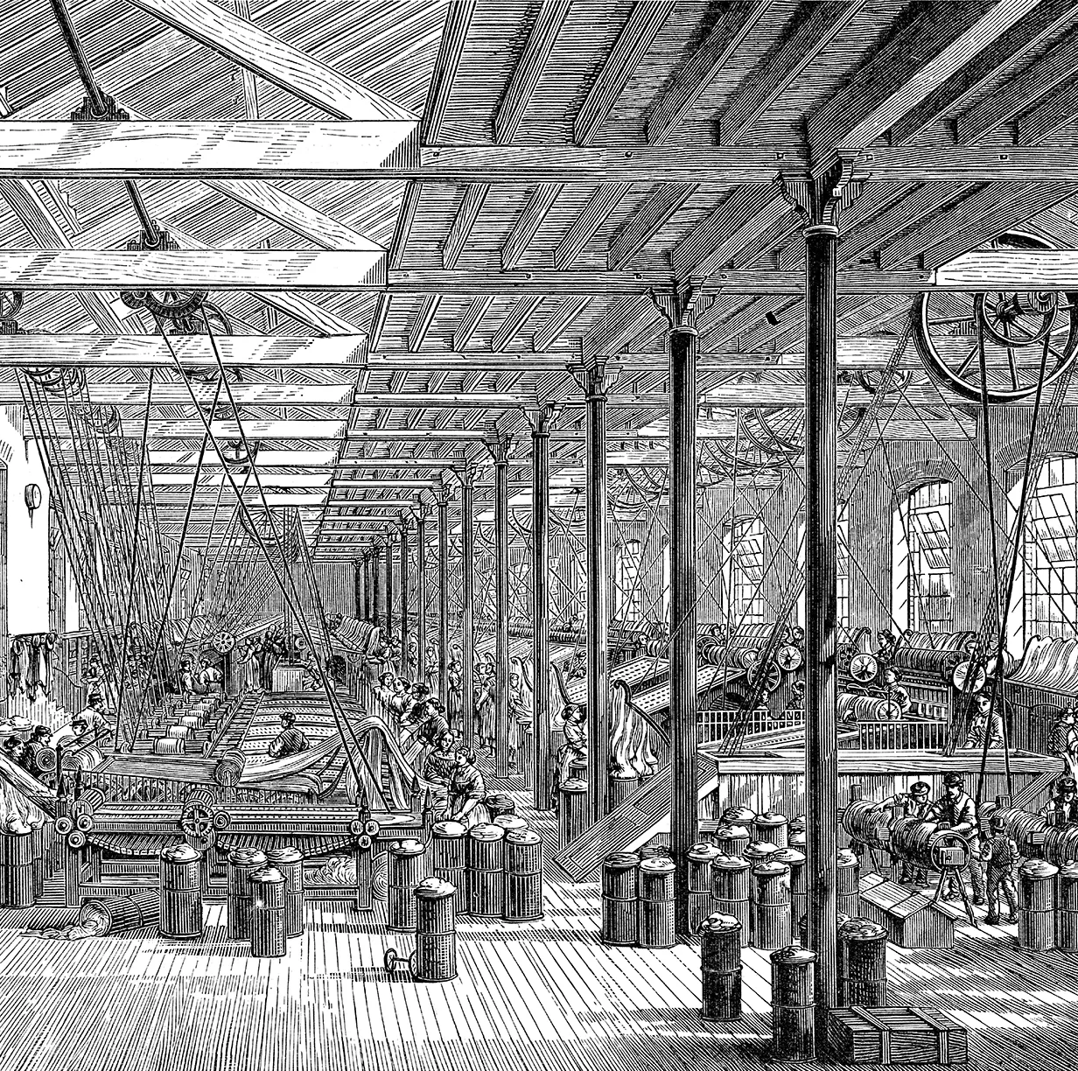
The British were in the middle of their Industrial Revolution, which means they needed raw materials to feed their factories. Many of these raw materials came from the American colonies.

Slide 7
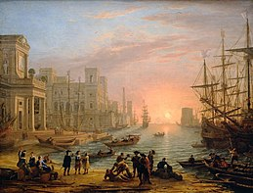
The British also needed markets to sell their finished goods. The American colonies were one place the British could sell these goods.

Slide 8
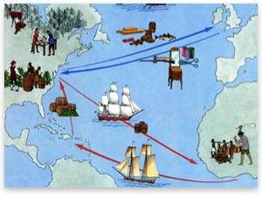
The Navigation Acts during the 1650s are a good example of these mercantilism policies.

Slide 9
The Navigation Acts were laws created by Parliament which stated:
-The colonies could only trade with England or English colonies.
-If the colonies wanted to trade with other countries, goods had to be shipped on British ships and merchants had to pay a tax to the British.

Slide 10
However, many of these, and other laws passed by Parliament were not enforced.
Why?
Distance- America is far away from England.
England was often distracted by problems at home and with other countries.
Royal governors in the colonies were supposed to enforce the law.

Slide 11
However, many of these, and other laws passed by Parliament were not enforced.
Why?
It was expensive to enforce the laws.
The colonies flourished more without regulations which led to more prosperity.

Slide 12
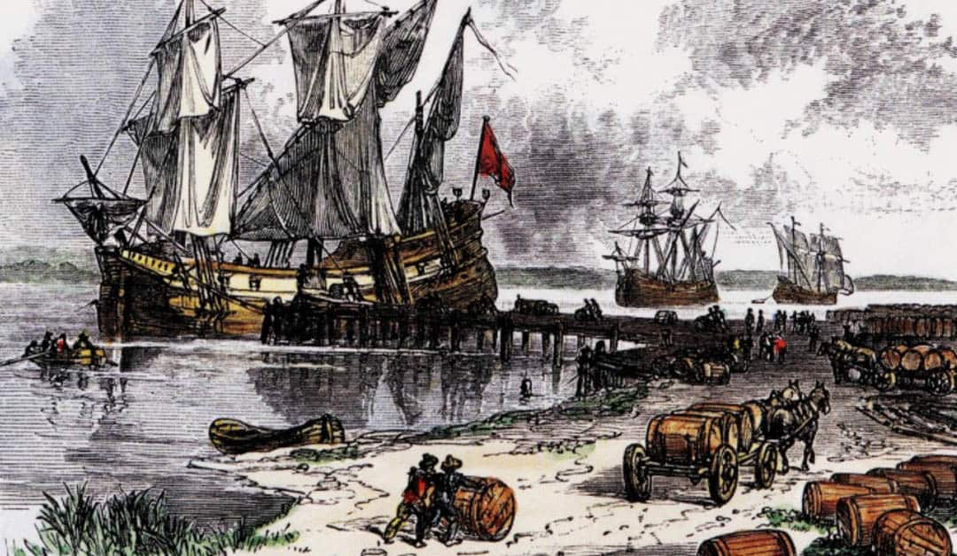
This became an unofficial British policy called salutary neglect.

Slide 13
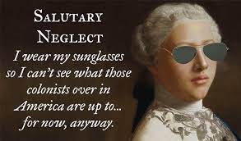
Salutary neglect was when Parliamentary rules and laws were loosely or not enforced on the American colonies and trade.

Slide 14
What effect do you think the policy of salutary neglect had on the colonists?
-Gave colonists the opportunity to become more prosperous.
-Allowed colonists to establish self-government.
-Allowed colonists to feel a sense of freedom in their lives.

Slide 15
Exit Question
What do you think would happen if the British reversed their ideas about salutary neglect?

